Slide 1
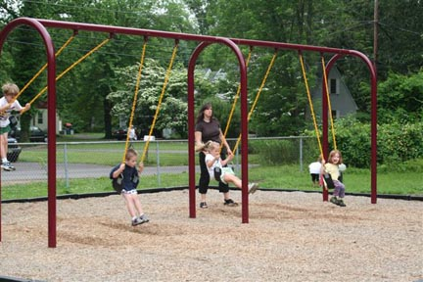
A Quick Java
Swing Tutorial

Slide 2
Introduction
Swing – A set of GUI classes
  Part of the Java's standard library
  Much better than the previous library: AWT
    Abstract Window Toolkit
Highlights
  A rich set of widgets
    Widget: Any GUI element (also called: components)
  Contents and shape are separated (MVC support)‏
  Fine-grained control over the behavior and look and feel
  Platform independent
    Isolates the programmer from the operating system's GUI

Slide 3
Swing Components
Containers
  Contain and manage other components.
  Top Level/Internal
  Examples: JFrame (Top Level), JScrollPane, JPanel.
Basic controls
  Atomic components
  Used for showing ouput and/or getting some input
  Inherits JComponent
  Examples: JButton, JLabel, JTextArea, JTable, Jlist
Usually every Swing class extends the corresponding AWT class
  For backward-compatibility reasons

Slide 4

My First Swing Program
import javax.swing.*;
import java.awt.BorderLayout;
public class First {
public static void main(String[] args) {
JFrame frame = new JFrame("My First Frame");
// operation to do when the window is closed.
frame.setDefaultCloseOperation(JFrame.EXIT_ON_CLOSE);
frame.getContentPane().setLayout(new BorderLayout());
frame.getContentPane().add(new JLabel("I Love Swing"),
BorderLayout.CENTER);
frame.pack();
frame.setVisible(true);
}
}

Slide 5
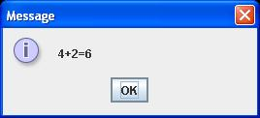
Top Level Containers: JDialog
javax.swing.JDialog:
  More simple and limited than frames
  Typically used for showing a short message on the screen
  Also has a border and a title bar
  May have an owner
    If the owner is invisible the dialog will also be invisible
  Use the static method of JoptionPane to show standard dialog boxes:
  JOptionPane.showMessageDialog(null, "4+2=6");

Slide 6
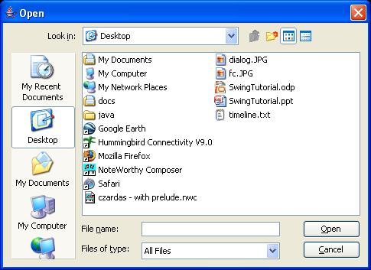
Top Level Containers: JFileChooser
javax.swing.JFileChooser:
  Allows the the user to choose a file
  Supports “open” and “save”: showOpenDialog(),showSaveDialog()‏
JFileChooser fc = new JFileChooser();
int returnVal = fc.showOpenDialog(null);
if(returnVal == JFileChooser.APPROVE_OPTION)
System.out.println("File: " + fc.getSelectedFile());

Slide 7
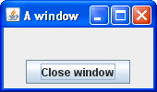
Top Level Containers: JFrame
javax.swing.JFrame:
  Top-level window with a title and a border.
  Usually used as a program's main window

Slide 8
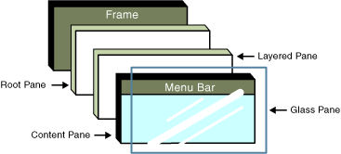
More on JFrame
Made of several layers
Widgets are added to the Content Pane layer.
  Use getContentPane() to obtain it
Other layers are used for customizing the window's appearence

Slide 9
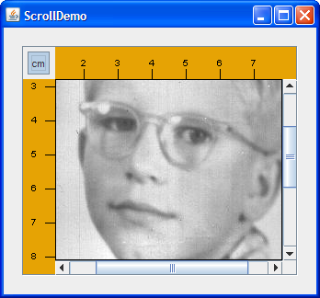
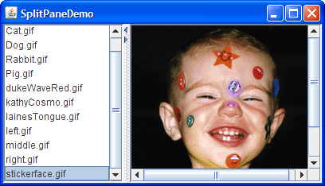
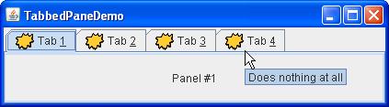
Internal Containers
Not Top level containers
Can contain other non-top level components
Examples:
  JScrollPane: Provides a scrollable view of its
  components
  JSplitPane: Separates two components
  JTabbedPane: User chooses which
  component to see

Slide 10
Containers - Layout
Each container has a layout manager
  Determines the size, location of contained widgets.
Setting the current layout of a container:
void setLayout(LayoutManager lm)
LayoutManager implementing classes:
  BorderLayout
  BoxLayout
  FlowLayout
  GridLayout

Slide 11
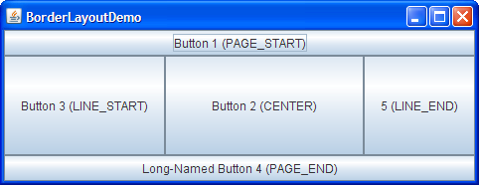
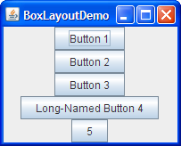
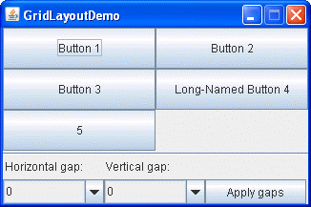

Containers - Layout

Slide 12
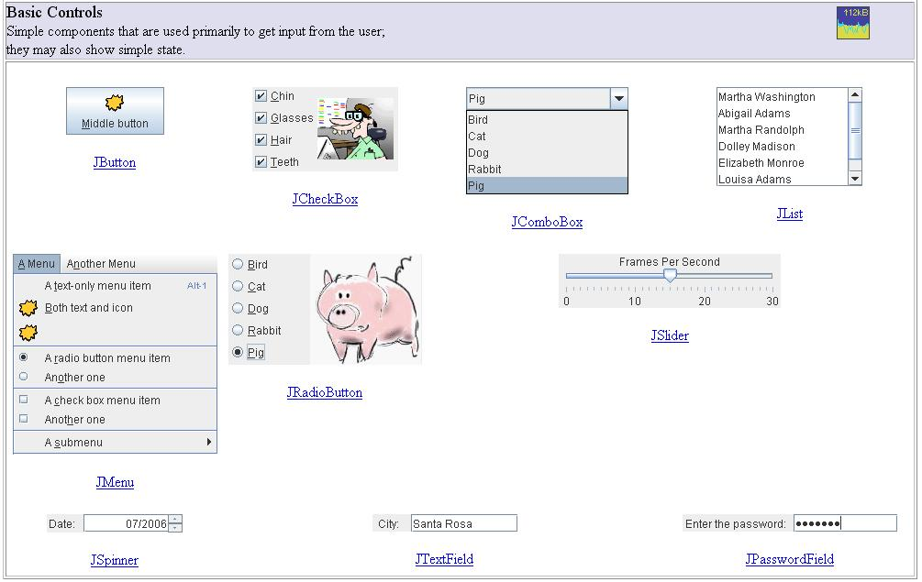
Swing Components

Slide 13
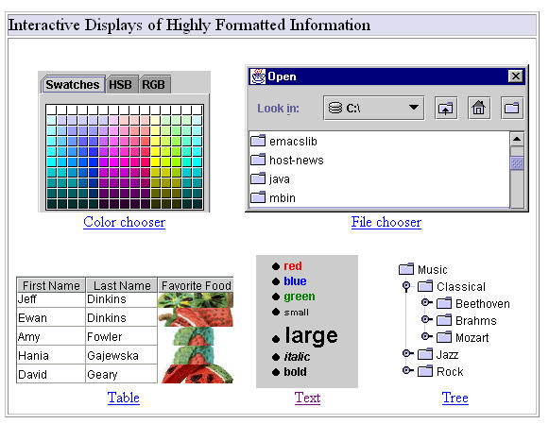
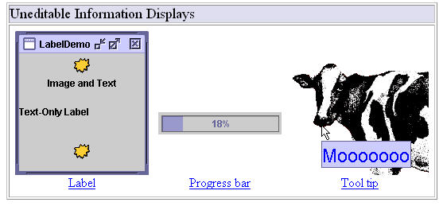
Swing Components

Slide 14
First Swing Program Revisited
Create a frame
import javax.swing.*;
import java.awt.BorderLayout;
public class First {
public static void main(String[] args) {
JFrame frame = new JFrame("My First Frame");
// operation to do when the window is closed.
frame.setDefaultCloseOperation(JFrame.EXIT_ON_CLOSE);
frame.getContentPane().setLayout(new BorderLayout());
frame.getContentPane().add(new JLabel("I Love Swing"),
BorderLayout.CENTER);
frame.pack();
frame.setVisible(true);
}
}
Choose the border layout
Create a text label
Add the label to the content pane
Specify CENTER as the layout position

Slide 15
Input
So we now know how to present widgets on the screen
A program also needs to react to the user's actions
Examples:
  When the user presses a button we want to save a file
  When the user closes the program we want to ask “are you sure?”
  ...
Swing mechanism: Events and Listeners

Slide 16
Events, Listeners
Swing defines all sorts of Listener interfaces
  E.g.: ActionListener, MouseMotionListener,
  WindowListener, ...
public interface ActionListener extends EventListener {
public void actionPerformed(ActionEvent e);
}
public interface MouseMotionListener extends EventListener {
public void mouseDragged(MouseEvent e);
public void mouseMoved(MouseEvent e);
}
There are default (empty) implementations for many of the listeners
  E.g.: MouseMotionAdapter, WindowAdapter

Slide 17
Events, Listeners (cont.)‏
A listener is an object that implements a listener interface
If we need to react to an event (on a certain widget) we register a listener object with that widget
E.g.: addActionListener() registers an action listener with its receiver:
JButton button = new JButton();
ActionListener listener = ...;
button.addActionListener(listener);
When an event occurs, all registered listeners are notified
  The appropriate listener method (e.g: actionPerformed()) is invoked
  An object describing the event is passed as a parameter

Slide 18
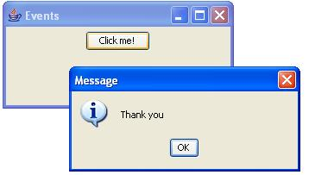
Event Handling Demo: GUI

Slide 19
Event Handling Demo: Code
import javax.swing.*;
import java.awt.*;
import java.awt.event.*;
public class Events implements ActionListener {
public Events() {
JFrame frame = new JFrame("Events");
frame.setDefaultCloseOperation(JFrame.EXIT_ON_CLOSE);
frame.getContentPane().setLayout(new FlowLayout());
JButton b = new JButton("Click me!");
b.addActionListener(this);
frame.getContentPane().add(b);
frame.pack();
frame.setVisible(true);
}
public void actionPerformed(ActionEvent e) {
JOptionPane.showMessageDialog(null, "Thank you");
}
public static void main(String[] args) { new Events(); }
}

Slide 20
Inner Classes
Nested within another classes
Instance specific:
  Has access to methods & fields of the object that created it
  => An inner class has TWO this variables
Can be static
  Can access only static members and methods only
  A static method cannot create a non-static inner class

Slide 21
Local Classes
Same as inner classes but defined inside a method
Has access to local variables of the enclosing method
  Only if the variable is defined as final
Can be anonymous
  Doesn’t have a name.

Slide 22
Event Handling Demo: Local Class
import javax.swing.*;
import java.awt.*;
import java.awt.event.*;
public class Events {
public Events() {
JFrame frame = new JFrame("Events");
frame.setDefaultCloseOperation(JFrame.EXIT_ON_CLOSE);
frame.getContentPane().setLayout(new FlowLayout());
JButton b = new JButton("Click me!");
b.addActionListener(new ActionListener() {
public void actionPerformed(ActionEvent e) {
JOptionPane.showMessageDialog(null, "Thank you");
}
});
frame.getContentPane().add(b);
frame.pack();
frame.setVisible(true);
}
public static void main(String[] args) { new Events(); }
}

Slide 23
Accessing Fields of Enclosing Object
public class A {
int x = 0;
public void f() {
B b = new B();
b.g();
System.out.println(x); // Output: 5
}
public class B {
public void g() { x = 5; }
}
public static void main(String[] args) {
new A().f();
}
}

Slide 24
Using the Second this Variable
public class A {
public void f() {
B b = new B();
System.out.println(b.g()); // Output: 1024
}
public int g() { return 512; }
public class B {
public int g() { return A.this.g() * 2; }
}
public static void main(String[] args) {
new A().f();
}
}

Slide 25
Appendix:
Contact Book Program

Slide 26
Swing's JTable
Each JTable has a TableModel object that holds the data shown by the table.
DefaultTableModel is a default implementation of TableModel
  By default it makes all the cells editable
We can customize its behavior by subclassing
  Or we can implement TableModel from scratch
TableModelListener - a listener interface
  Notified of changes in the model
Use TableModel.addTableModelListener() to register a listener object

Slide 27
Contacts Book example overview
Each contact has a name and a list of attributes
  Each attribute has a name and a value.
Operations:
  Add contact
    Contact name is immutable
  Add attributes
    Attribute is identified by it’s name, the attribute name is immutable, it’s value can be changed
Classes:
  Contact: represents a contact and maintains list of attributes
  Contact.Attribute: Inner class that represents contact attribute.
  ContactTableModel: model class for the table data
    Doesn’t allow to modify attribute names
  ContactBook: represents the contact book widget.

Slide 28
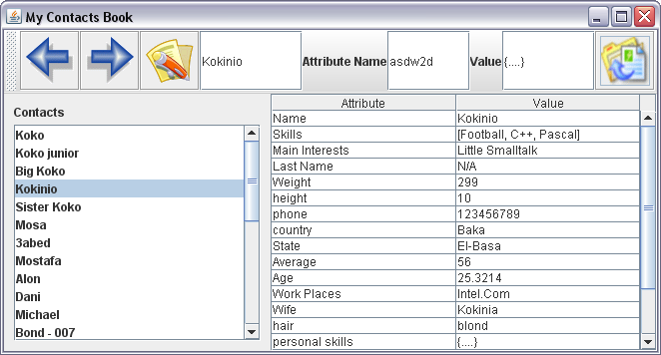
Contacts Book example overview

